Slide 1
RUNGTA COLLEGE OF DENTAL SCIENCES & RESEARCH
ABSCESS
DEPARTMENT OF GENERAL SURGERY

Slide 2
Specific learning Objectives
At the end of this presentation the learner is expected to know ;
Core areas* | Domain ** | Category #
ABSCESS | Cognitive | Must Know
HILTONS METHOD | Cognitive | Must Know
PYAEMIC ABSCESS | Cognitive | Must Know
COLD ABSCESS | Cognitive | Must Know
TUBERCULAR LYMPHADENITIS | Cognitive | Must Know

Slide 3
Table of Content
ABSCESS
ABSCESS
HILTON'S METHOD
PYAEMIC ABSCESS
COLD ABSCESS
TUBERCULAR LYMPHADENITIS

Slide 4
ABSCESS
Definition- It is a localised collection of pus in a
cavity.
Pus-It is a mixture of dead WB cells,dead
and multiplying bacteria,toxins and
dead necrotic tissues.
Classification-
A) Pyogenic abscess
B) Pyaemic abscess
C) Cold abscess

Slide 5
Pyogenic abscess-
* commonest form of abscess
* can be subcuteneous or deep or in a viscera
* Usually caused by staphylococcal organism.
* Enters in soft tissue either by direct external
wound or haematogenous route or in a
existing cellulitis.

Slide 6
PATHOPHYSIOLOGY-
Following injury, there is inflammation of the parts. With this inflammation the events
are summurised below-
INFLAMMATION
BLOOD VESSELS AND EXUDATION | RETICULOENDOT-HELIAL RESPONSE | ROLE OF BACTERIA
PERMEABILITY + Exudation of proteins Fibrin formation Pyogenic membrane forms | Macrophages and polymorohs Releases lysosomal enzymes Liquefaction of tissue Pus formation | Release of toxins and enzymes Tissue destruction Pus formation

Slide 7
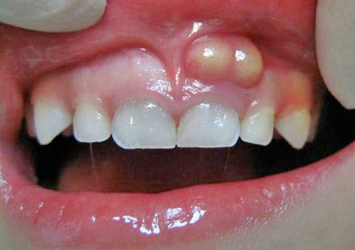

Slide 8
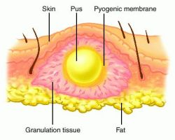

Slide 9
Causetive agents- Common organisms are-
1.Staphylococcus aureus
2.Streptococcus pyogenes
Pre disposing factors-
1.Malnourishment
2.Anaemia
3.Diabetes people
4.HIV,immunosuppresive patient
5.Old age
Other factors-
1. Trauma & wound contamination
2.Haematoma
3.Virulence of the organism

Slide 10
Clinical features-
1.Throbbing pain
2.Fever with chills and rigors
3. Soft ,smooth, tender with fluctuant
swelling with often visible pus is seen.
4. Brawny indurations in surrounding skin area
5.Redness,warmth and restricted movement
of the part present.
THE CLASSICAL SIGN OF INFLAMMATION
Calor,Tumor,Dolar ,Rubor,Loss of function &
positive fluctuation test

Slide 11
Investigation-
1.Routine blood exam
2.Blood sugar
3.Aspiration of pus and its culture+sensitivity
Treatment-
1. Incision and drainage of abscess cavity
by Hilton’ method.
2.Suitable antibiotic.
3.Symptomatic treatment.
4.Dressing of wound

Slide 12
HILTON’S METHOD OF PUS DRAINAGE

Slide 13
There are total 10 Steps of Hilton’s Method of
Incision and Drainage.
These are as follows. 1. Topical anaesthesia: Topical anaesthesia is achieved with the help of ethyl chloride spray.
2. Stab incision: made over a point of maximum fluctuation in the most dependent area along the skin creases, through skin and subcutaneous tissue.
3. If pus is not encountered, further deepening of surgical site is achieved with sinus forceps (to avoid damage to vital structures).

Slide 14
4. Closed forceps are pushed through the tough deep fascia and advanced towards the pus collection.
5. Abscess cavity is entered and forceps opened in a direction parallel to vital structures.
6. Pus flows along sides of the beaks.
7. Explore the entire cavity for additional loculi.
8. Placement of drain: A soft yeat’s or corrugated rubber drain is inserted into the depth of the abscess cavity; and external part is secured with the wound margin by sutures.

Slide 15
9. Drain left for at least 24 hours.
10. Dressing: dressing is applied over the site of incision taken extraorally without pressure.
Modified hilton’s method-When the abscess
is on or near the some important anatomical structure , then instead of using stab knife, the abscess cavity is opened using
Sinus forcep. By this way damage to vital structure can be prevented.
****
*******

Slide 16
Complications of abscess-
1.Bacteraemia, Septicaemia and pyaemia
2.Metastatic abscess formation
3.Destruction of tissue due to necrosis.
4.Antibioma
5.Sinus and fistula formation
6.Erosion of adjacent blood vessel leading to hemorrhage.
7.Specific complications of internal abscess-
Brain ,liver abscess etc.

Slide 17
Differential diagnosis-
Aneurysm –specially Popliteal,femoral and
Axillary aneurysms.
2. Soft tissue sarcomas-soft,smooth warmth
having dilated veins over surface.
*****

Slide 18
Pyaemic Abscess
*These are formation of multiple abscess in
different parts of body.
*It is due to lodging of multiple infective
bacterial emboli from the circulating blood.
*Emboli lodged there suppurates and forms
abscess in that part of body.
*They may be at subfascial plane or deeper
plane,in the organ(liver,brain,kidney)
* They do not have signs of acute abscess
like warmness,fluctuation or pointing tender.

Slide 19
COLD ABSCESS
It is a chronic abscess due to a chronic disease. Most commonly, it is tuberculosis.
Rarely cold abscess can be seen in Actinomycosis, Leprosy n Madura foot.
As the abscess has no intense signs of inflammation, it is called COLD ABSCESS.

Slide 20
Tubercular Lymphadenitis
Etiology
Caused by Mycobacterium tuberculi
Route of entry
80% thru. tonsillar crypts n affecting the L. nodes of ant. triangle.
20% cases, L. nodes in posterior triangle are involved due to infection thru. Adenoids.
Very rarely from TB of apex of lung.

Slide 21
Stages of TB lymphadenitis
Stage of adenitis
Stage of periadenitis
Stage of cold abscess
Stage of coller stud abscess
Stage of sinus formation

Slide 22
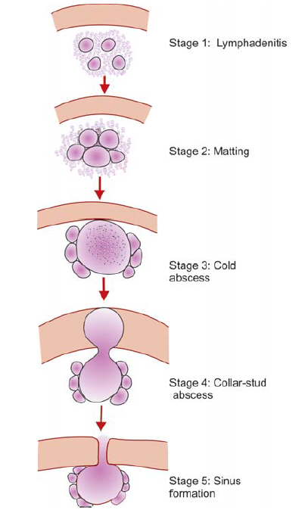

Slide 23
INVESTIGATION
CBC
ESR
CHEST X-RAY
SPUTUM FOR AFB
FNAC
LYMPH NODE BIOPSY
EDGE BIOPSY FROM SINUS

Slide 24
Medical Teatment
Anti Tuberculous Ttreatment [ATT]
Three drug regime INH, Rifampicin, Pyrazinamide
for two months followed by INH and Rifampicin
for another 4 months.
Dosage = INH—6mg/kg body wt.
=Rifampicin—10mg/kg body wt.
=Pyrazinamide—30mg/kg body wt.

Slide 25
Role of surgery
For lymph node biopsy
Non dependant aspiration of cold abscess.
Excision of Lymph nodes
Excision of sinus wall.
****

Slide 26
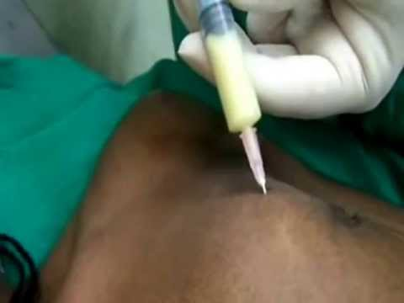
Non dependant aspiration of cold
abscess

Slide 27
REFERENCES
SRBS BOOK OF GENERAL SURGERY
A MANUAL ON CLINICAL SURGERY - S DAS
MANIPAL MANUAL OF SURGERY - K RAJGOPAL SHENOY
BAILEY AND LOVES SHORT PRACTICE OF SURGERY

Slide 28
Question & Answer Session
You may ask your doubts related to the topic?

Slide 29
THANK YOU

